Slide 1


Art/Srj
Rebecca Hollidge- c00300511
Sophia Stanley – c00299461
Jasmin Suter - c00301545

Slide 2

Theme Choice
Image sharing website, aimed at artists looking for commissions
What makes our website unique?
Requests page allows people to create requests for commissions that people can respond to
Focusing specifically on commissions, encouraging users to post portfolio pieces

Slide 3
Team Members
Rebecca Hollidge
Sophia Stanley
Jasmin Suter
Main, About, 404 Pages
Main style of website
Requests, Log in, FAQ Pages
Responsiveness
Profile, Terms of Service, Blog Pages
Site Map and Value Proposition

Slide 4

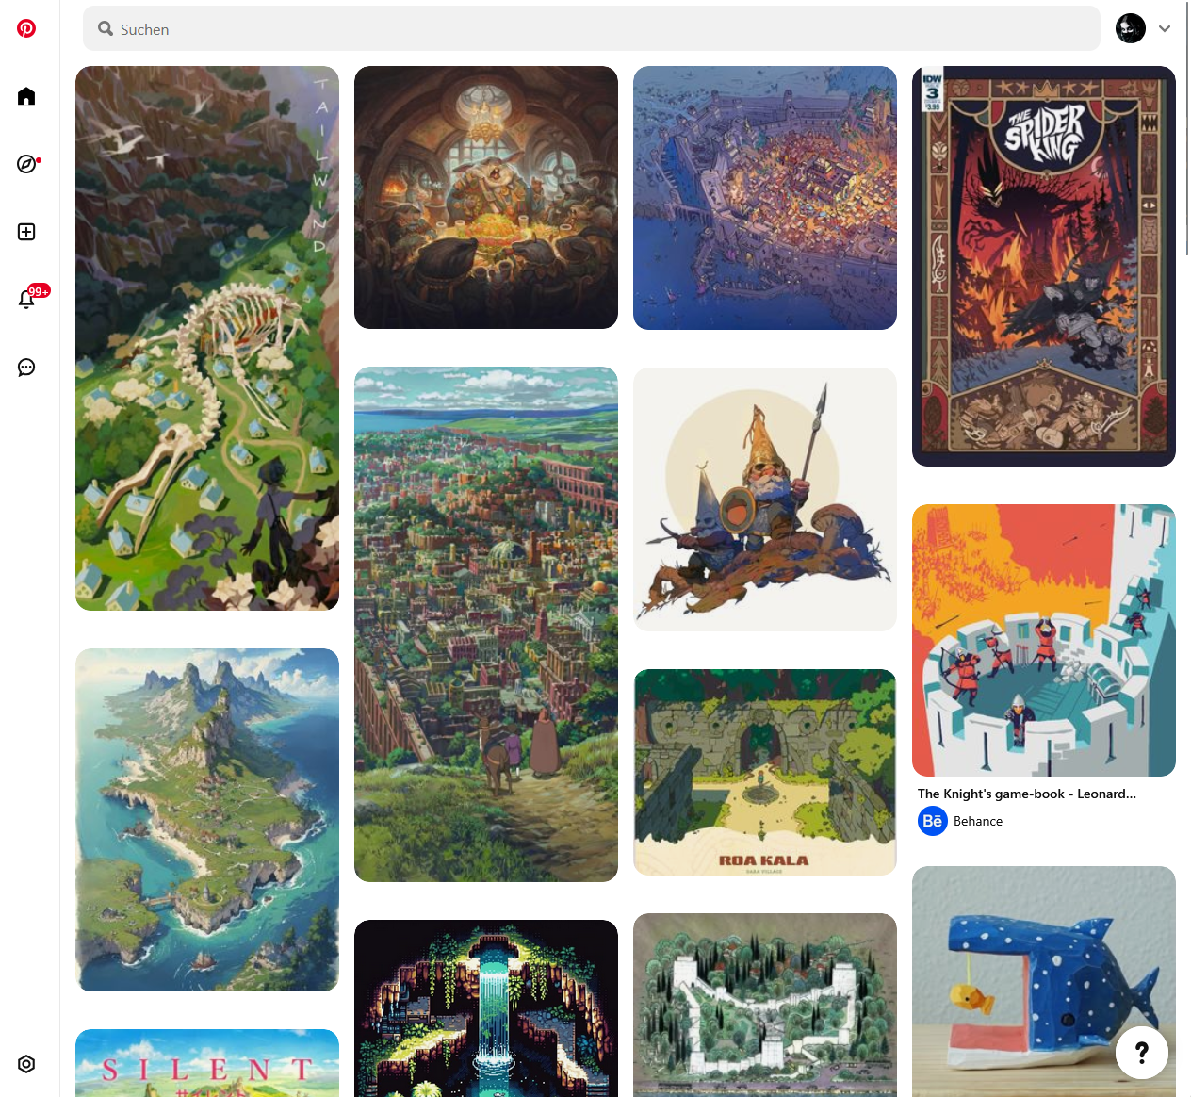
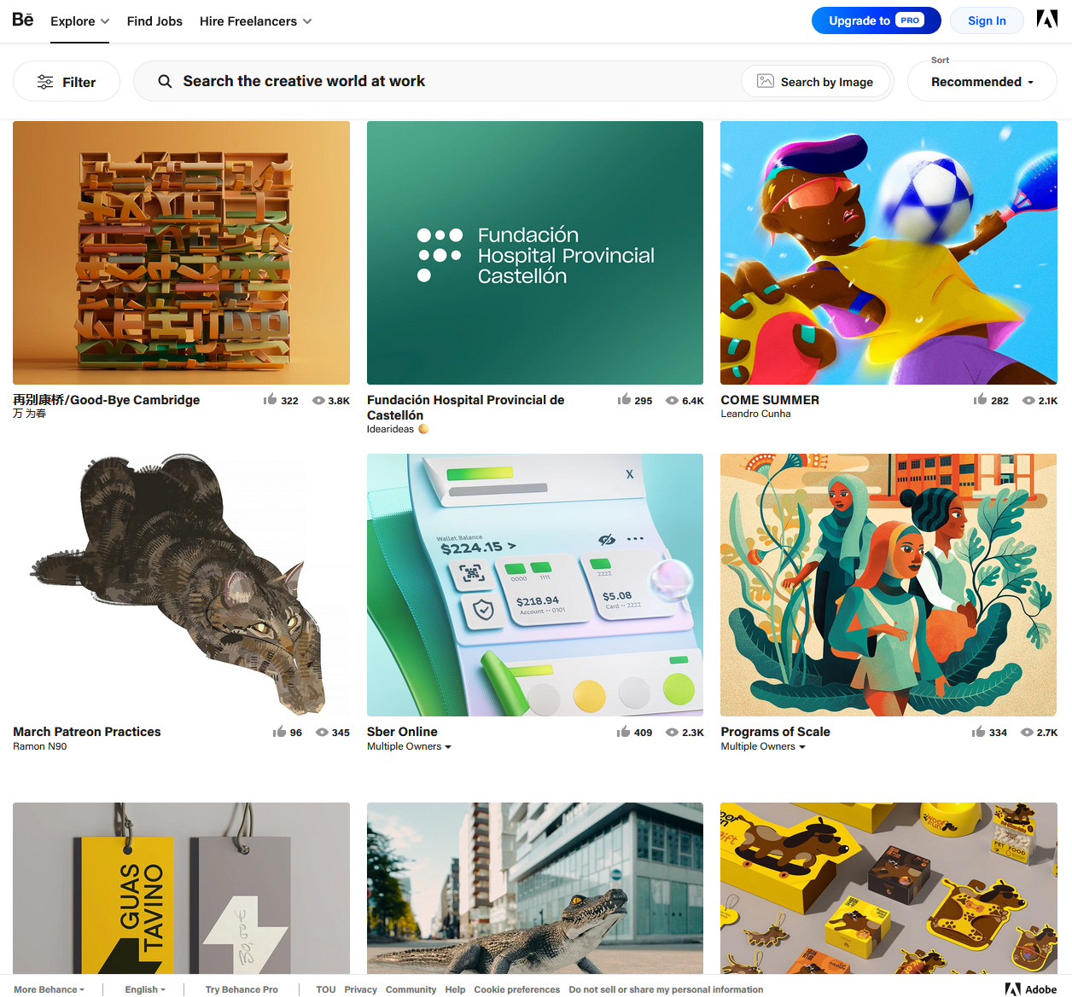
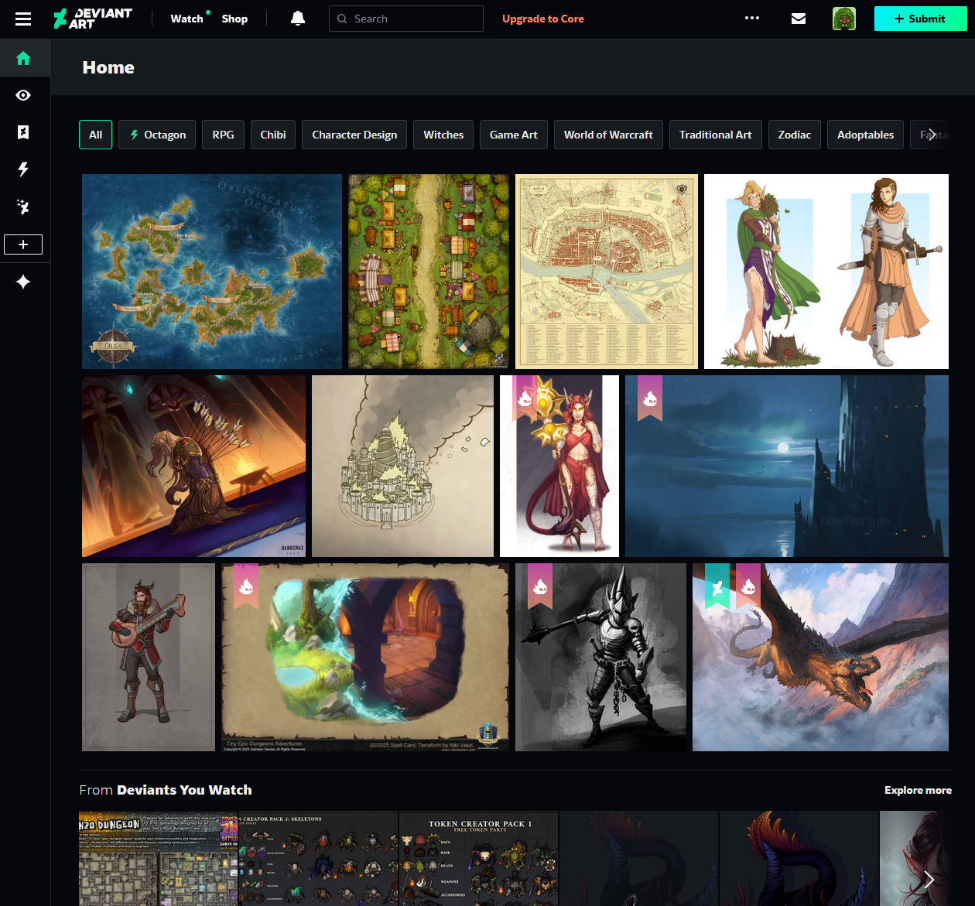
Initial Research
Pinterest
Behance
DeviantArt

Slide 5
Main Insights
Visible header with clear navigation
Focus on images through simple background
Black and White + Highlight colour
Highlight important features
Grid pattern for art

Slide 6
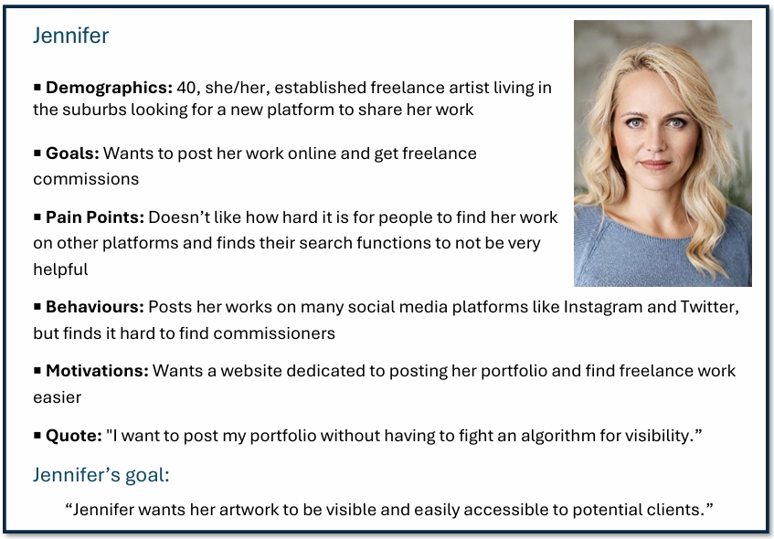
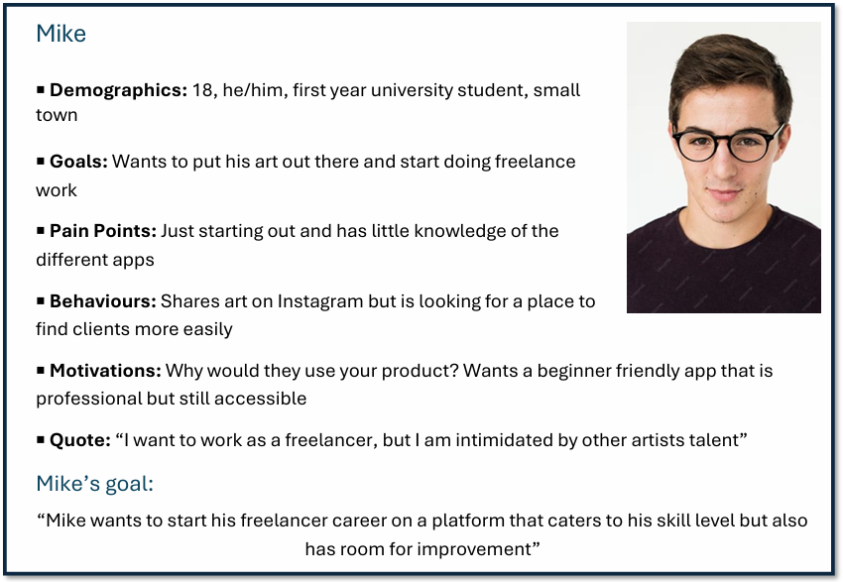
Audience Insights
3 Personas
Artists looking to get commissioned
Pain Points
Difficult to find specific images or artists
Organization and quality depends on users
Focus on AI instead of artists
Difficult to get noticed

Slide 7
Our goals
Share art | Browse Art | Find Artists
Allow users to organize their own content
Make it easy to get commissions
Provide easy to navigate search feature

Slide 8

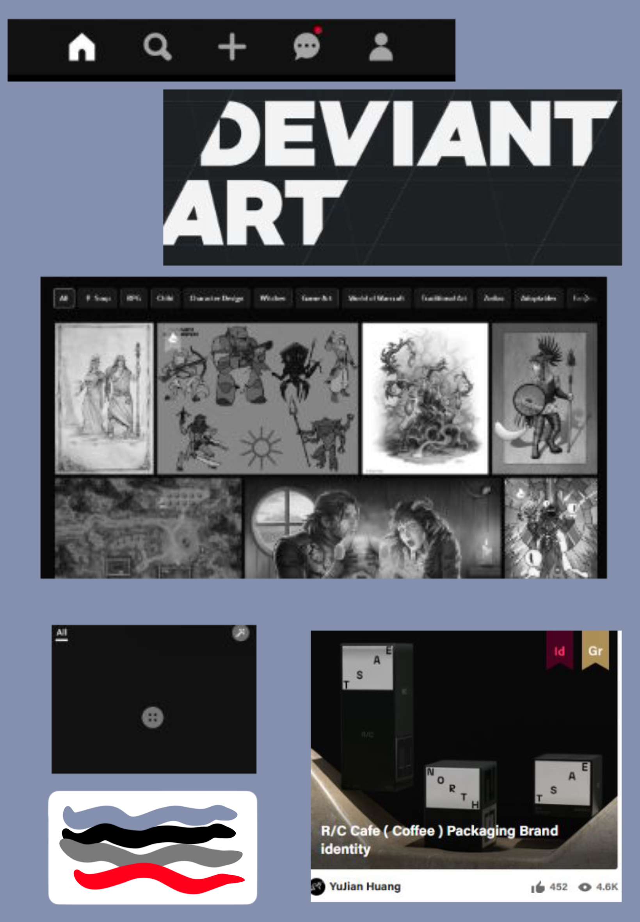

Drawing sketches and choices
The Beginning of
Art/srj

Slide 9
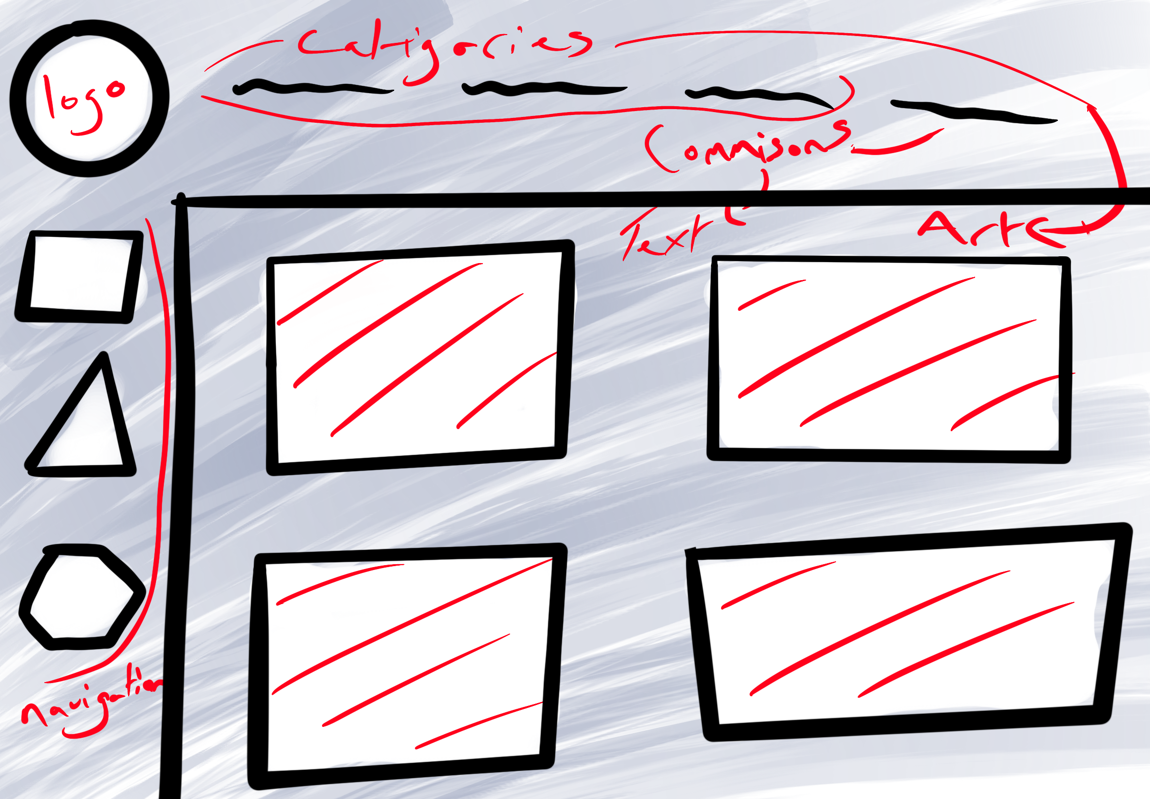
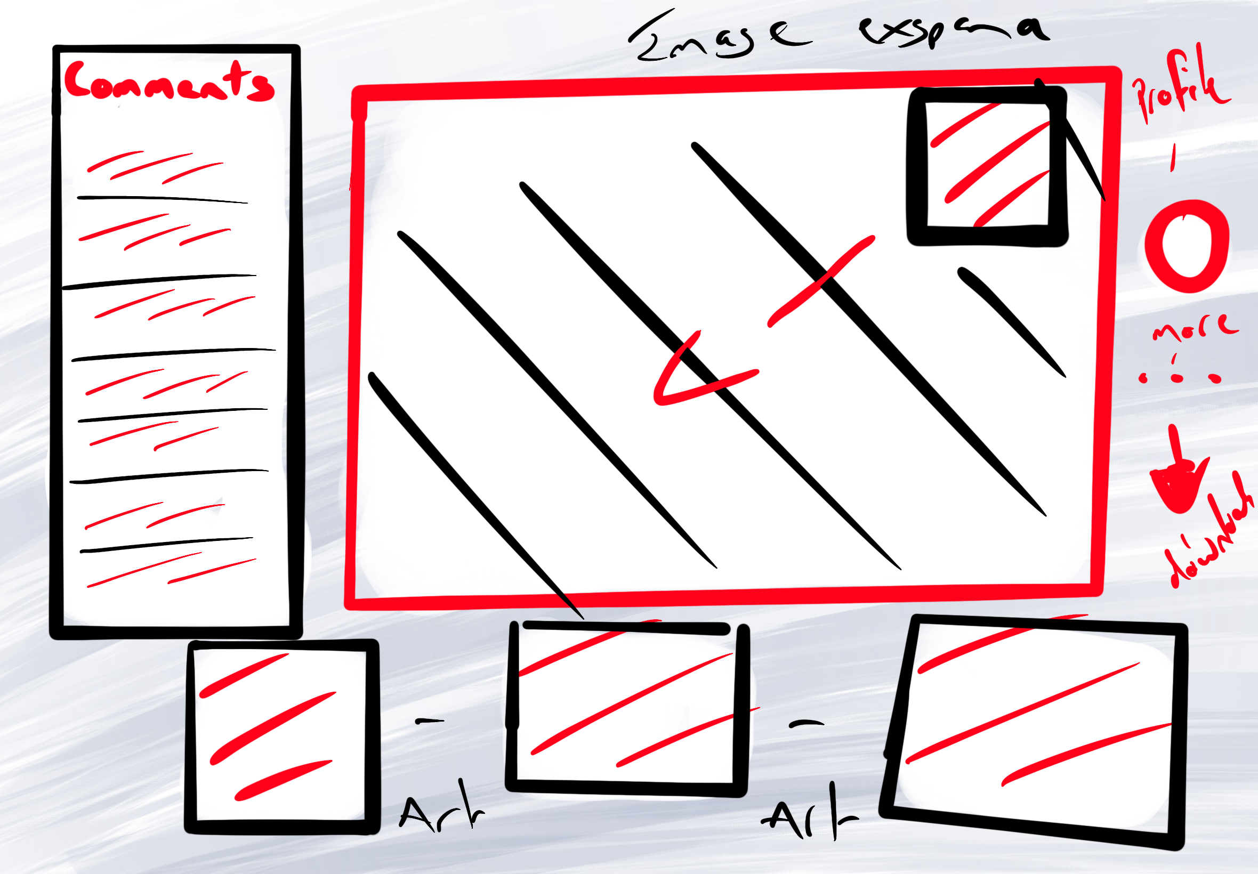
Main page
Expanded image

Slide 10
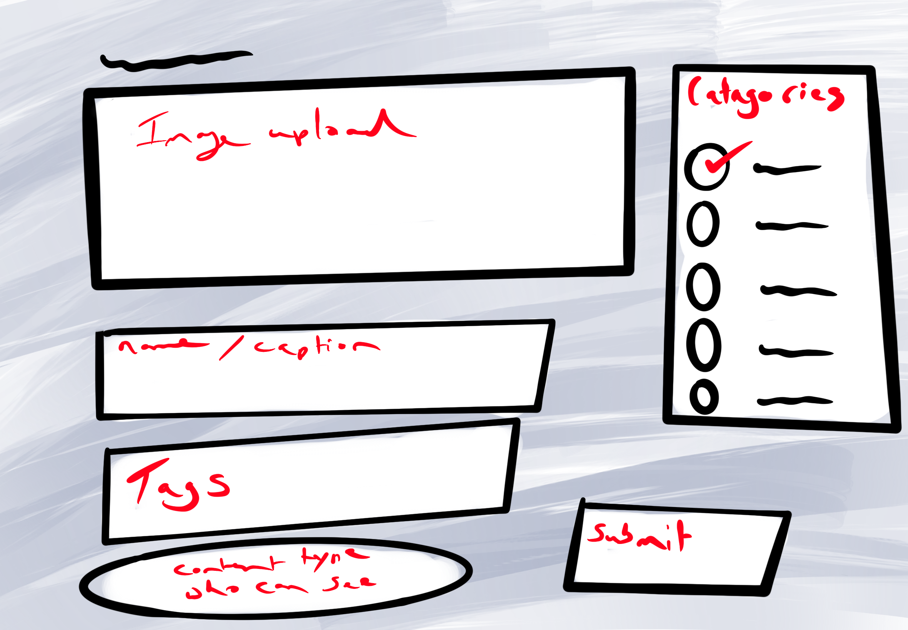
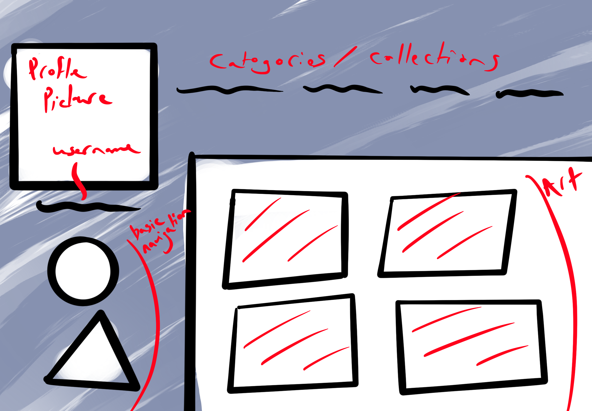
Upload page
profile

Slide 11
The current website

Slide 12
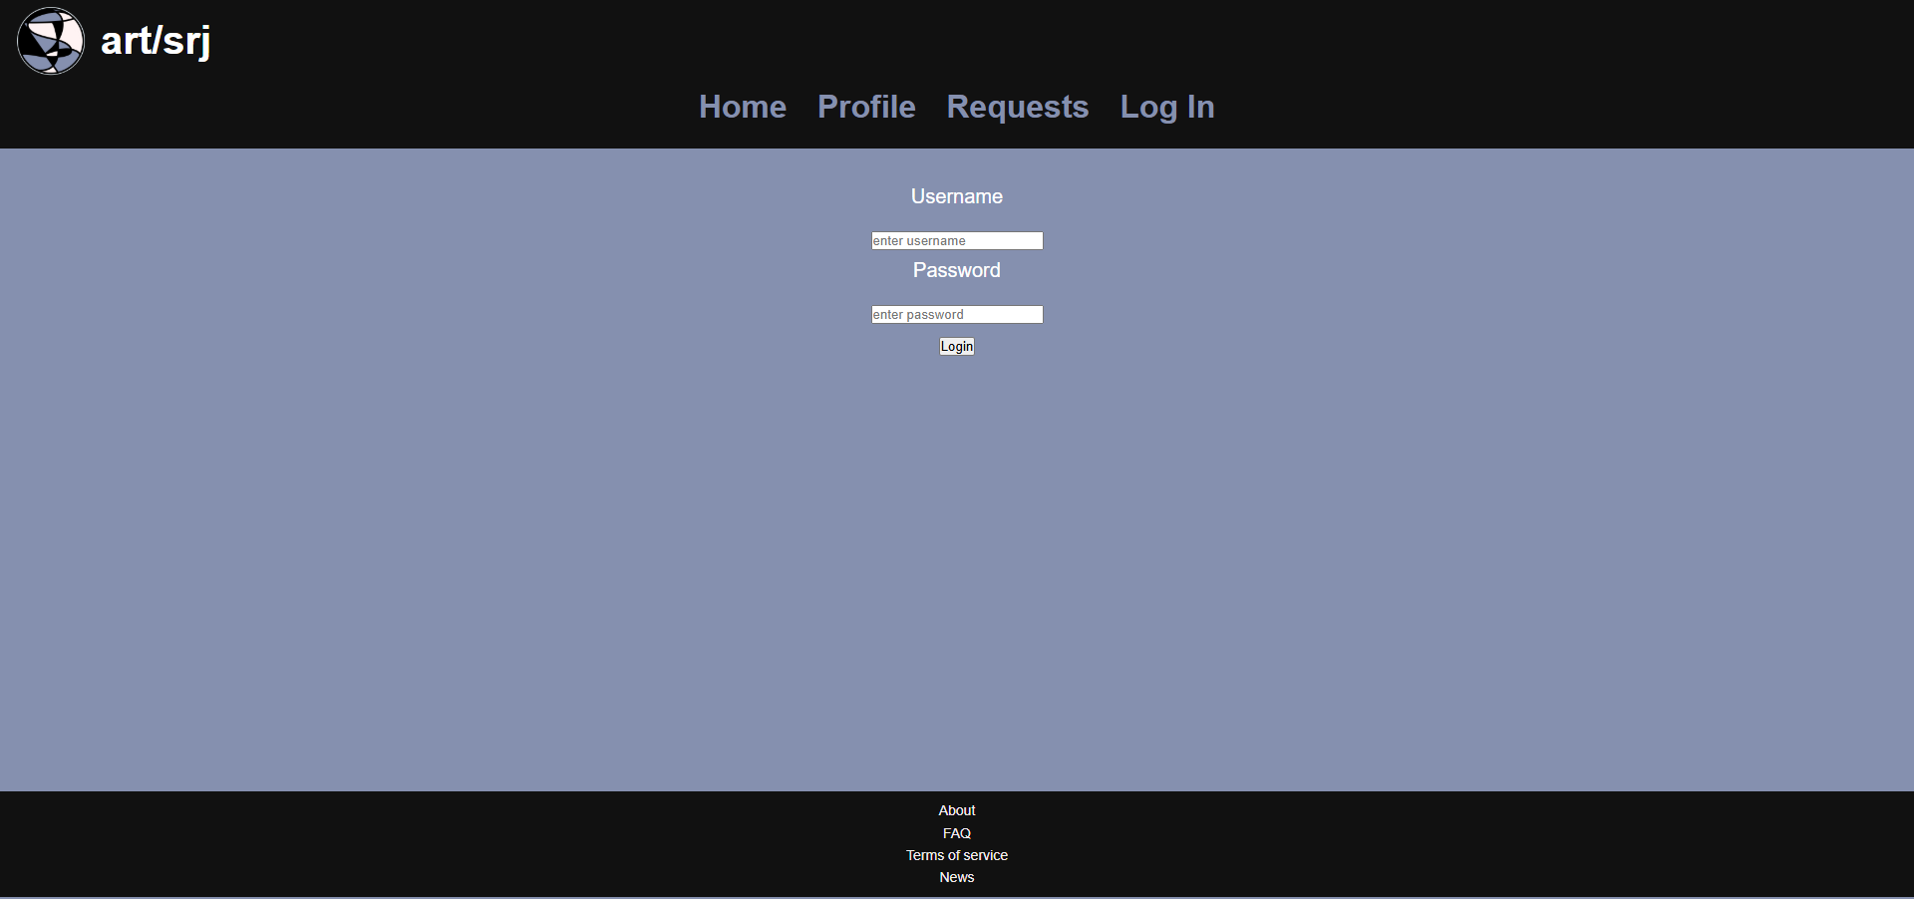
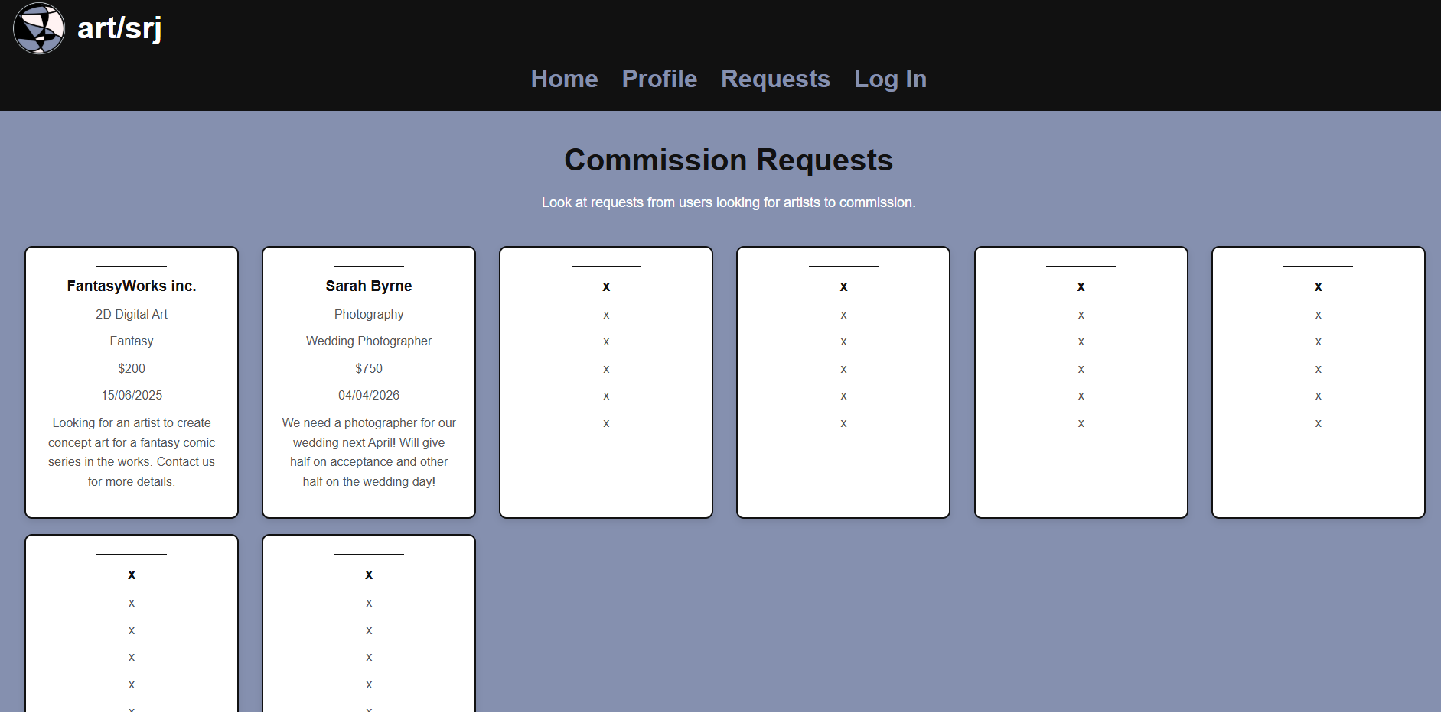
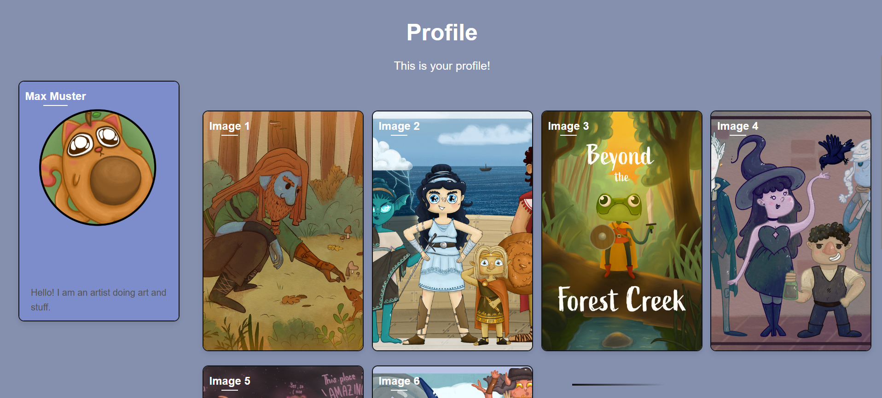
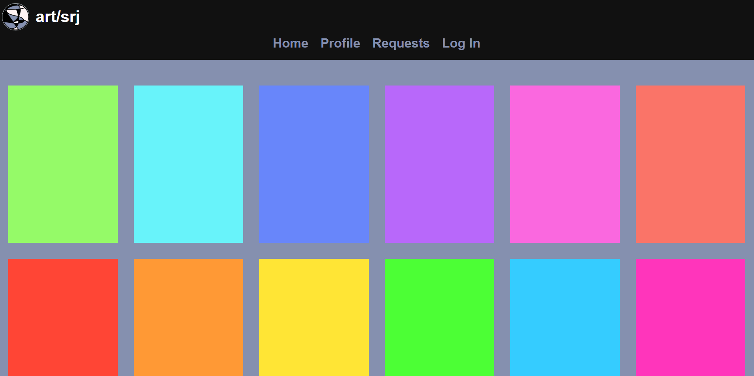

Slide 13
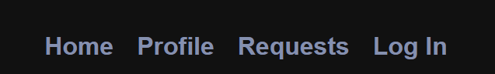


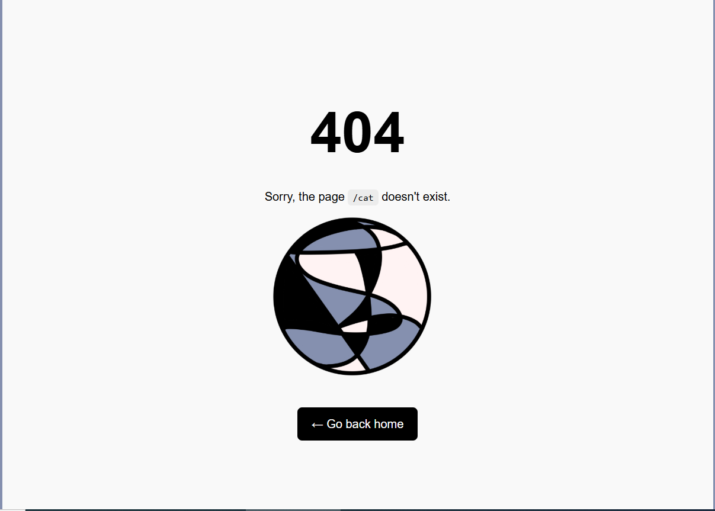
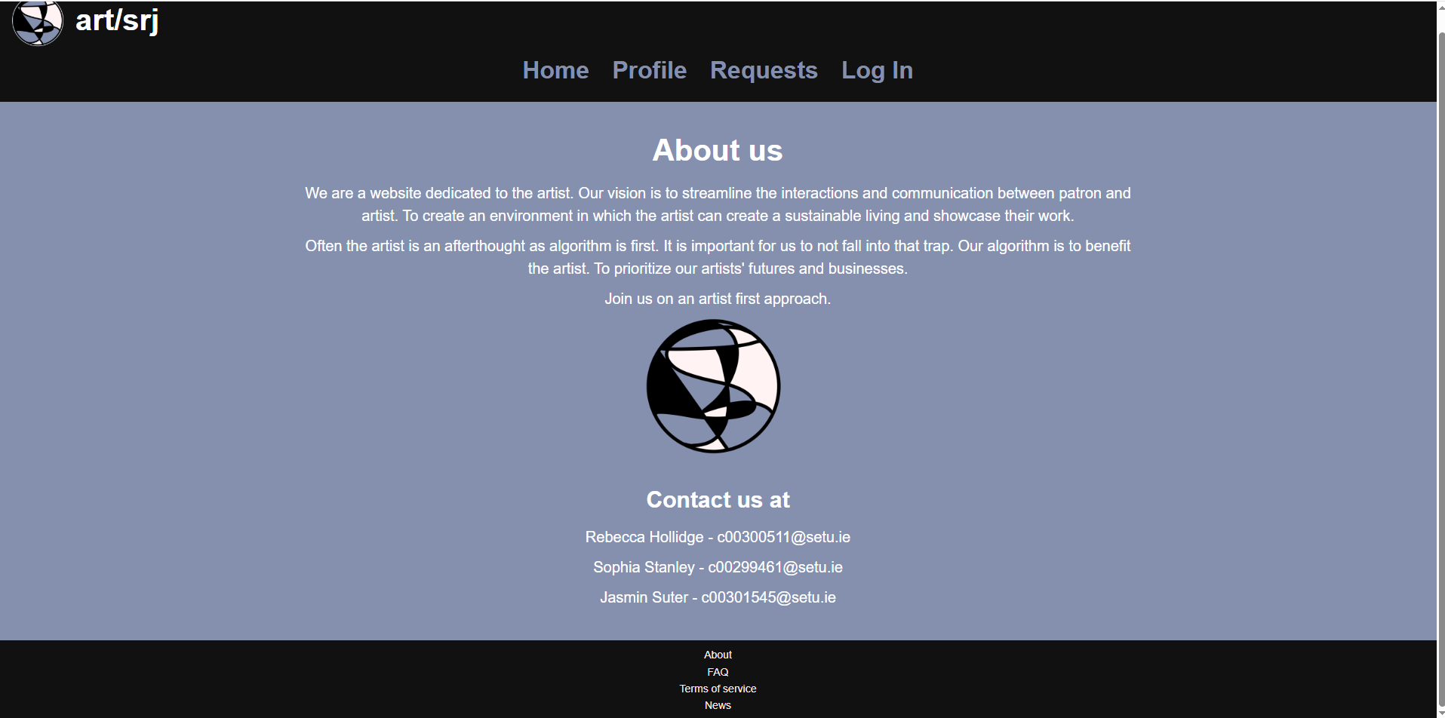

Slide 14

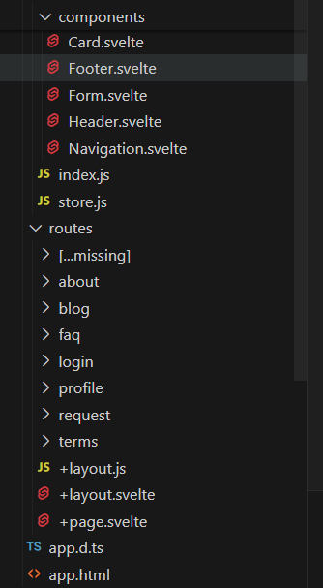
Developing the Website
9 Pages
3 pages each
Card component for profile page
Form component for requests page
Store.js for the login page

Slide 15
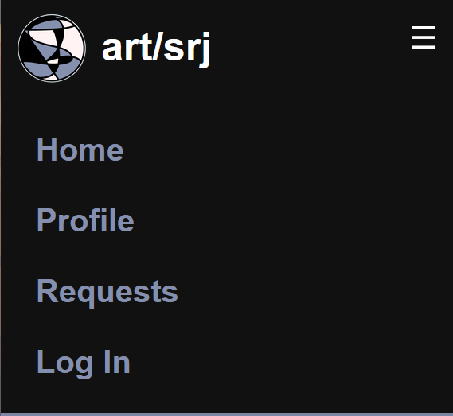
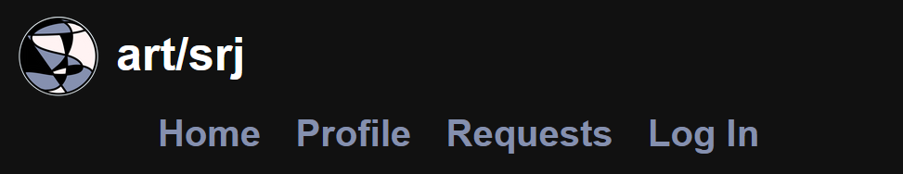
Responsiveness
Hamburger Menu

Slide 16
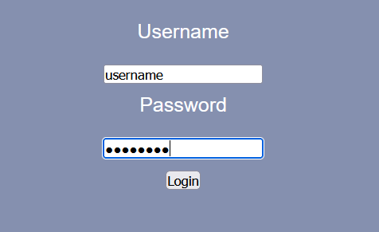
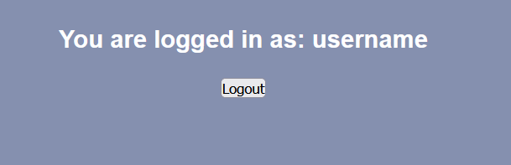
Interaction
Logging in

Slide 17
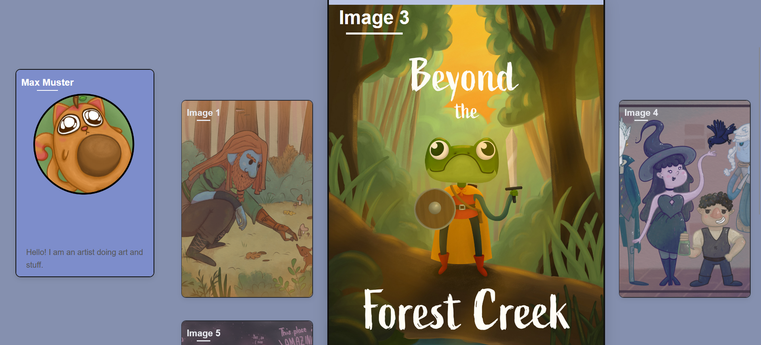
Profile Page

Slide 18
Key Takeaways
Future Improvements
Asking for help is important
Set realistic goals
Uploading images
Multiple users and profiles
Likes and Comments

Slide 19
Thank you :D

